Slide 1
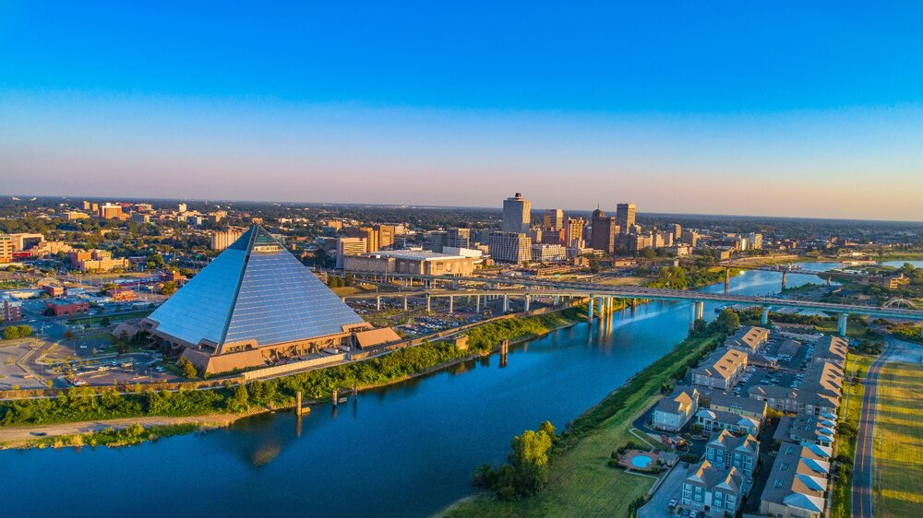

STRONG HEALTHY THRIVING NEIGHBORHOODS STRONG HEALTHY THRIVING NEIGHBORHOODS STRONG HEALTHY THRIVING NEIGHBORHOODS STRONG HEALTHY THRIVING NEIGHBORHOODS STRONG HEALTHY THRIVING NEIGHBORHOODS STRONG HEALTHY THRIVING NEIGHBORHOODS STRONG HEALTHY THRIVING NEIGHBORHOODS STRONG HEALTHY THRIVING NEIGHBORHOODS STRONG HEALTHY THRIVING NEIGHBORHOODS STRONG HEALTHY THRIVING NEIGHBORHOODS STRONG HEALTHY THRIVING NEIGHBORHOODS STRONG HEALTHY THRIVING NEIGHBORHOODS STRONG HEALTHY THRIVING NEIGHBORHOODS
NOMAN010520
FUNDING OVERVIEW & APPLICATION LAUNCH FOR REAL ESTATE PROJECTS NEIGHBORHOOD ECONOMIC DEVELOPMENT OPPORTUNITIES (NEDO)

Slide 2
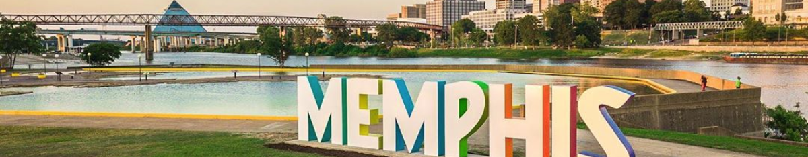

OVERVIEW OF CDBG POLICIES & PROCEDURES

Slide 3
COMMUNITY DEVELOPMENT BLOCK GRANT PROGRAM - CDBG
What is CDBG?
The primary objective of the CDBG program is the development of viable urban communities by providing funding for:
  Decent Housing,
  A Suitable Living Environment
  Expanded Economic Opportunities
  For persons of low- and moderate- income, defined as a person residing in a household with income at or below 80% of area median income adjusted for household size (LMI).
  CDBG PROGRAM REGULATIONS
  Code of Federal Regulations 24 Part 570

Slide 4
COMMUNITY DEVELOPMENT BLOCK GRANT PROGRAM - CDBG
CROSS CUTTING REGULATIONS
Environmental Review
Section 3
Davis Bacon (Labor Standards)
Section 504

Slide 5
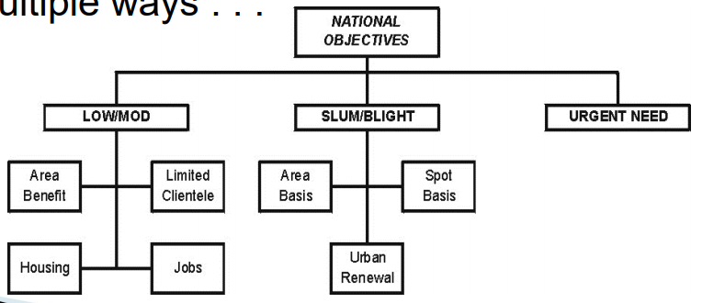
COMMUNITY DEVELOPMENT BLOCK GRANT PROGRAM - CDBG
National Objectives
Benefit Low and Moderate Income Persons
Prevent and Eliminate Slum and/or Blight
Meet An Urgent Need

Slide 6
COMMUNITY DEVELOPMENT BLOCK GRANT PROGRAM - CDBG
Eligible Activities
Economic Development
Acquisition
Public Facilities
Public Service
Housing Rehab

Slide 7
COMMUNITY DEVELOPMENT BLOCK GRANT PROGRAM - CDBG
Overview of CDBG Policies and Procedures
Organizational Overview
General Program Requirements
Cross-Cutting Requirements
CDBG Grant Management and Program Activities
Section 108 Program
Minimum Rehab Standards
5. ESG Grant Management and Program Activities
6. HOME Grant Management and Program Activities
7. HOPWA Grant Management and Program Activities

Slide 8
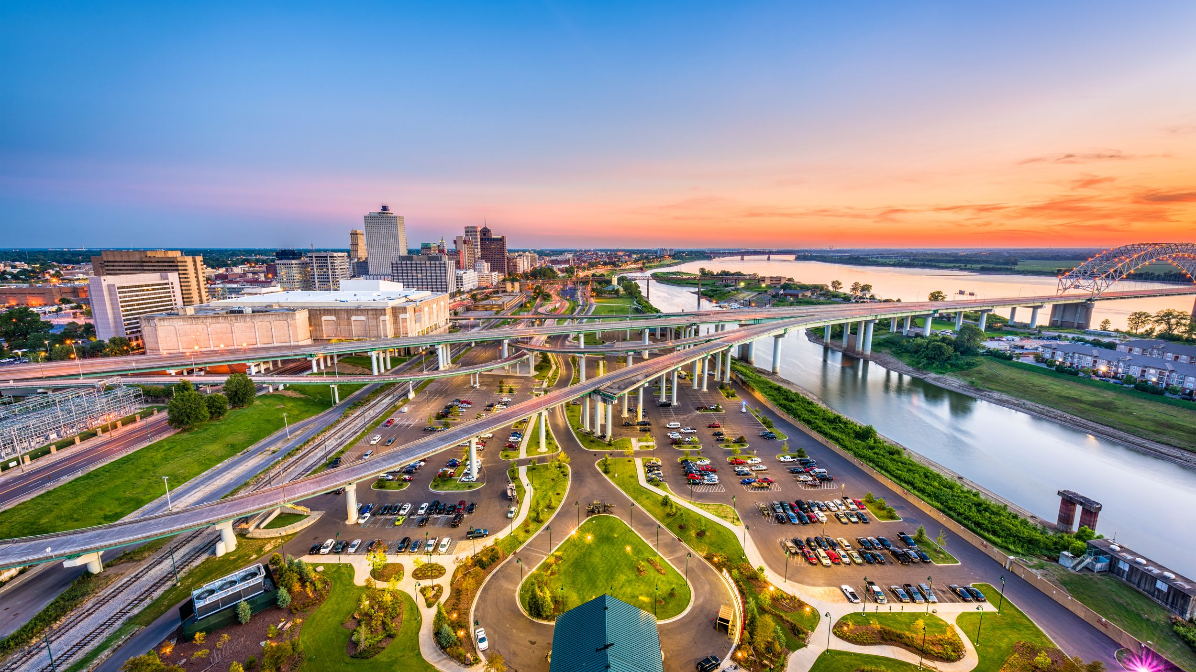
OVERVIEW OF ELIGIBLE REAL ESTATE ACTIVITIES
Commercial
Mixed Use
Public Facilities
Affordable Housing

Slide 9
NEIGHBORHOOD ECONOMIC DEVELOPMENT OPPORTUNITIES
GAP FINANCING OPPORTUNITIES
NEDO supports activities that nurture and energize neighborhood improvement projects and sustainable economic development opportunities.
  Special Economic Development Activities
  Acquisition, Construction, reconstruction, rehab or installation of commercial or industrial
  Financial assistance to private for-profit business in form of a loan or interest subsidies
  Commercial Rehabilitation or New Construction
  Mixed Use
  Public Facilities

Slide 10
APPLICATION PROCESS OVERVIEW

Slide 11
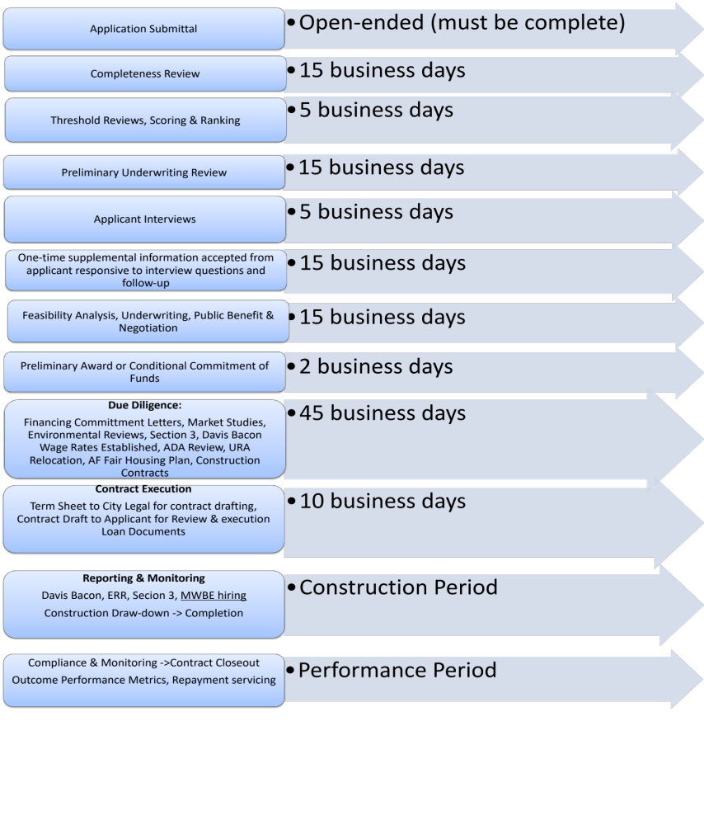
APPLICATION PROCESS
TIMELINE

Slide 12
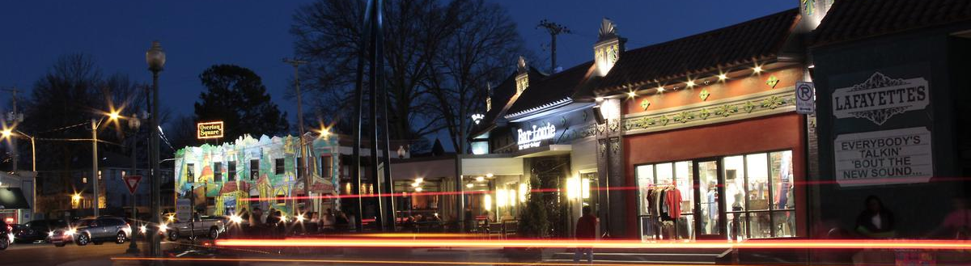
APPLICATION STEP BY STEP
APPLICATIONS WILL BE EVALUATED ACCORDING TO
Threshold Assessment
Project Prioritization
Underwriting Review
NOTE
Incomplete applications will not be considered
Applications not meeting threshold criteria will not be considered
APPLICATION CHECKLIST
Your guide to a complete application
Use it
Read all instructions

Slide 13
THRESHOLD REQUIREMENTS
SUBMISSIONS/EXHIBITS
Completed AFHMP
Site Plan
Site Control
Appraisal
An Executive Summary including a project timeline with a defined scope of work describing the population to be served
A detailed development budget and proforma in an unlocked Excel format
ALL APPLICATIONS MUST MEET THE FOLLOWING:
Project serves households at 80% or below the AMI (CDBG)
Project serves households at 60% or below AMI (HOME)
How the Project will comply with standards set by HUD Multifamily AFHMP - Form 935 2a has been completed (1)
One of the CDBG national objectives
Project must be located in the City of Memphis & include a site plan (2)
Use for CDBG $
Evidence of site control by Applicant (3)
Applicant must provide an appraisal supporting pro forma assumptions (4)

Slide 14
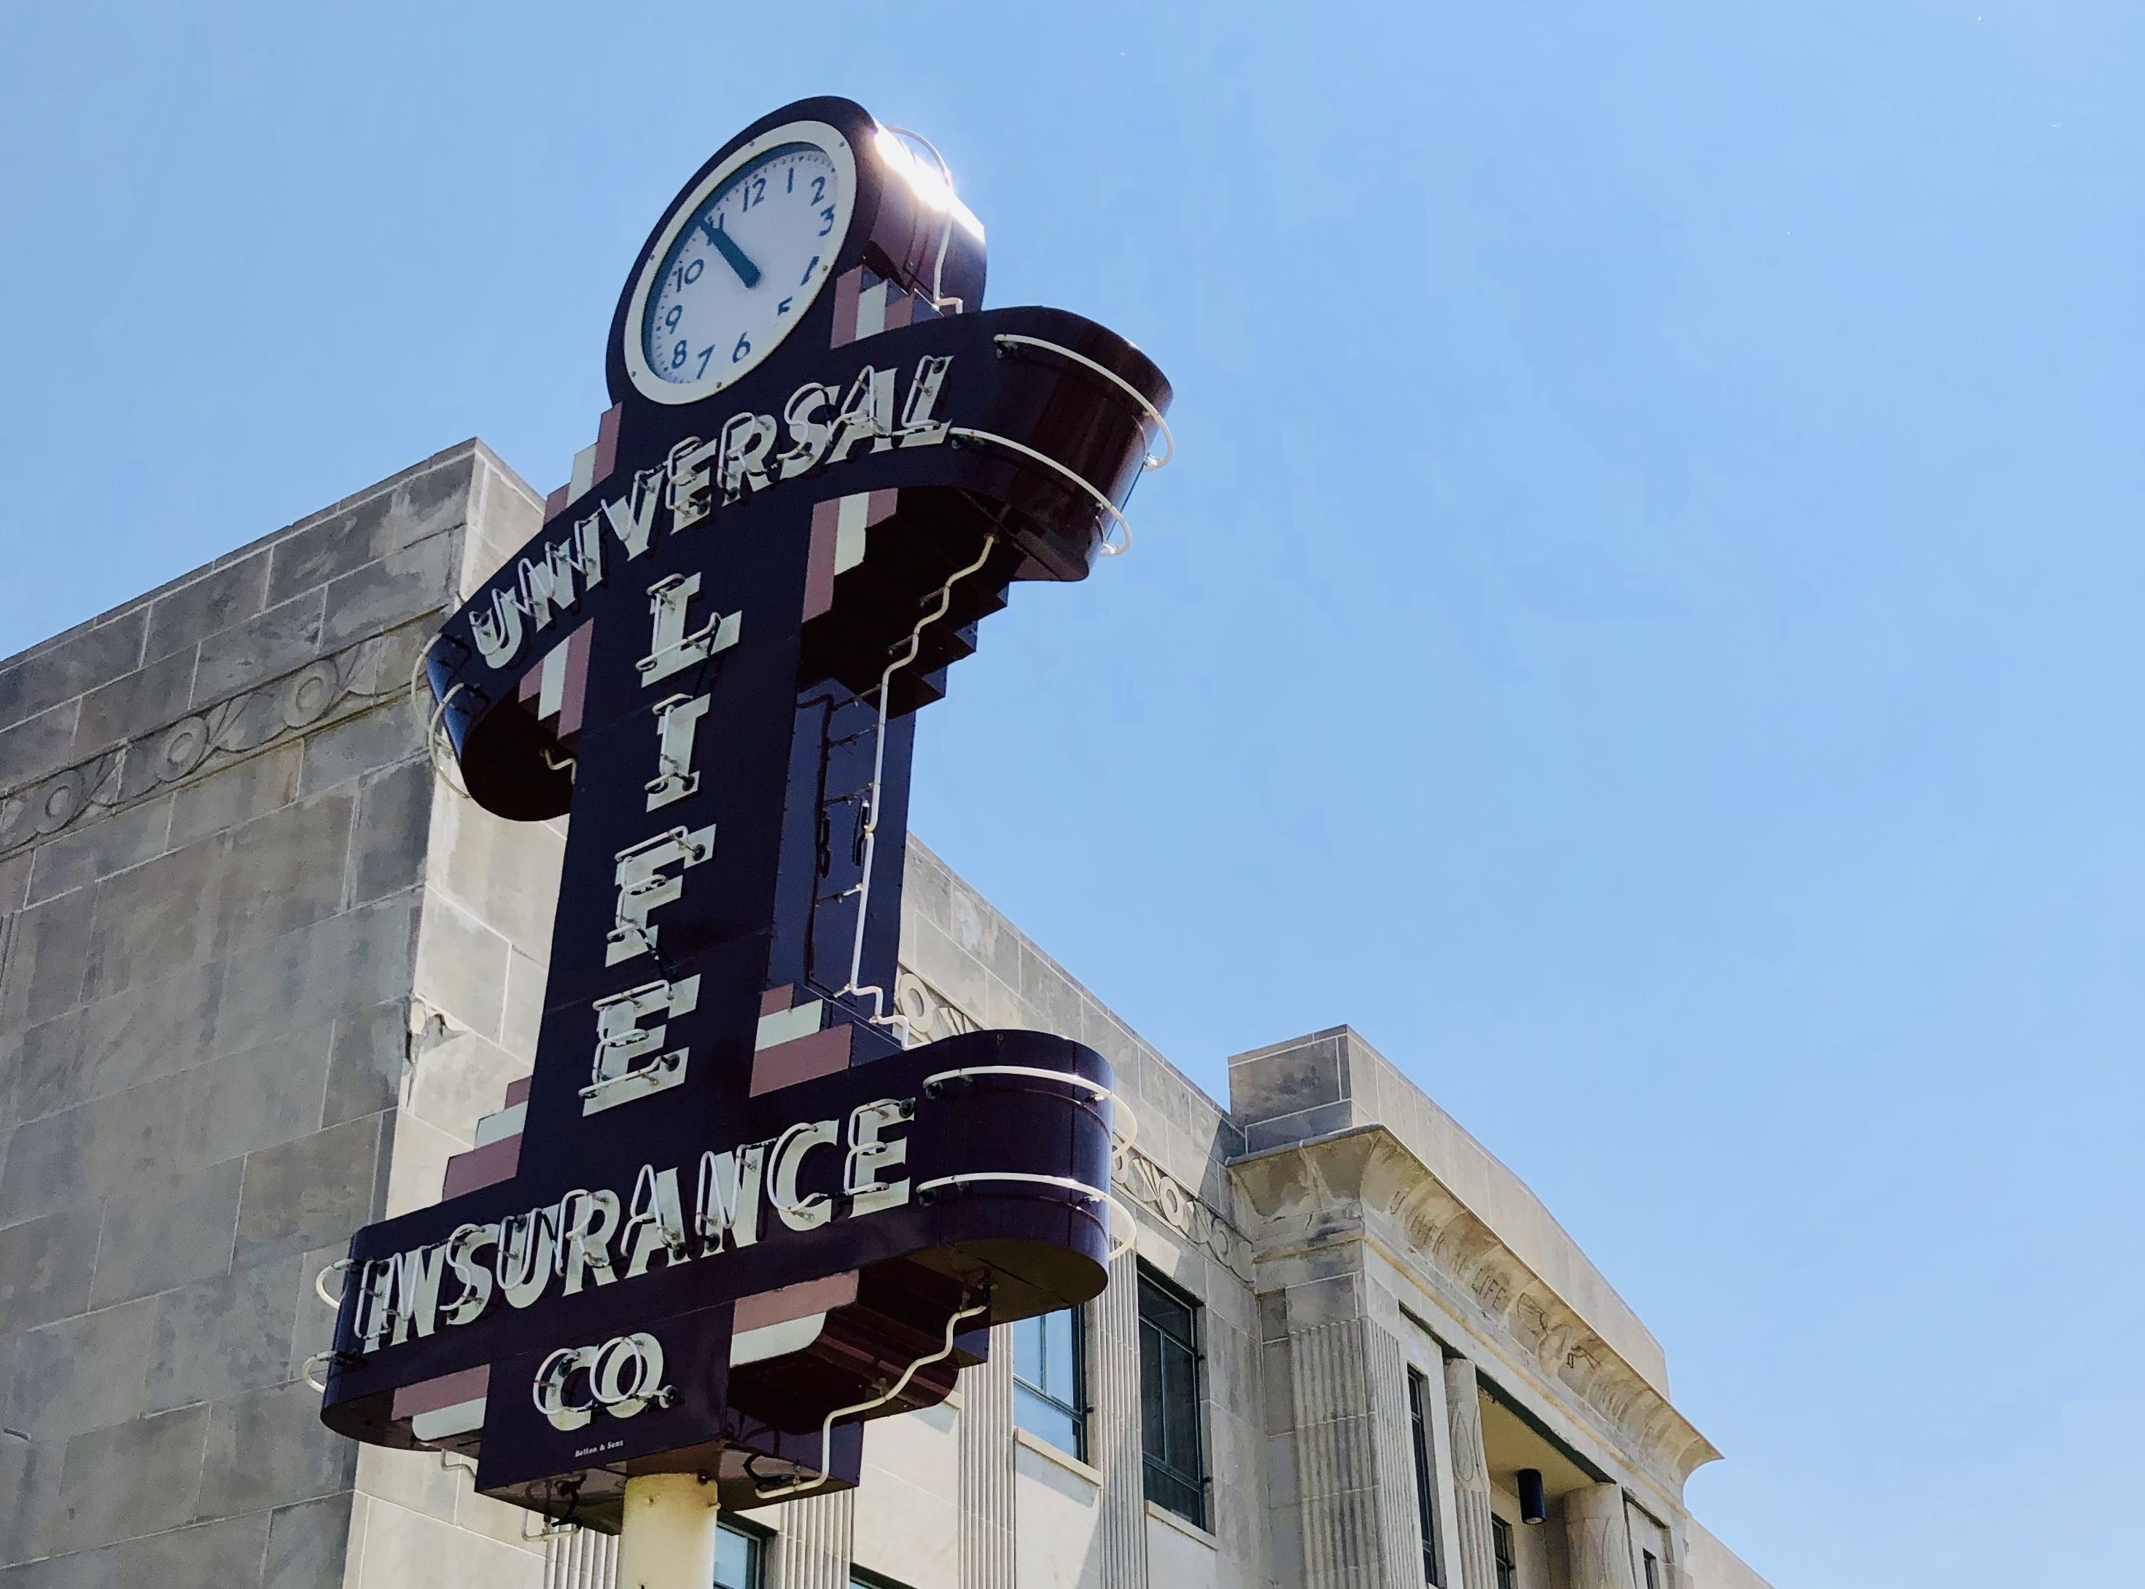
THE APPLICATION
General Info
Development Funding
Development Information (political & economic location)
Experience and Capacity (CDBG Funding & Property Management)
Project readiness (market study, Phase 1, zoning & entitlements, architectural & engineering estimates, total project budget completed)
Location amenities with map
HUD Regulatory Conditions (CHDO & City of Memphis Section 3)
Efficient Use of Federal Funds (leverage of CDBG/HOME)
Executive Summary with architectural renderings, detailed floor plans, including square footage and lot sizes
Conflicts of Interest Disclosure CDBG /HOME
Contracts Disclosure

Slide 15
Questions?
Completed applications can be sent to
HCDRealEstateApplications@memphistn.gov
www.memphistn.gov/hcd
(901) 636-7300

