Slide 1
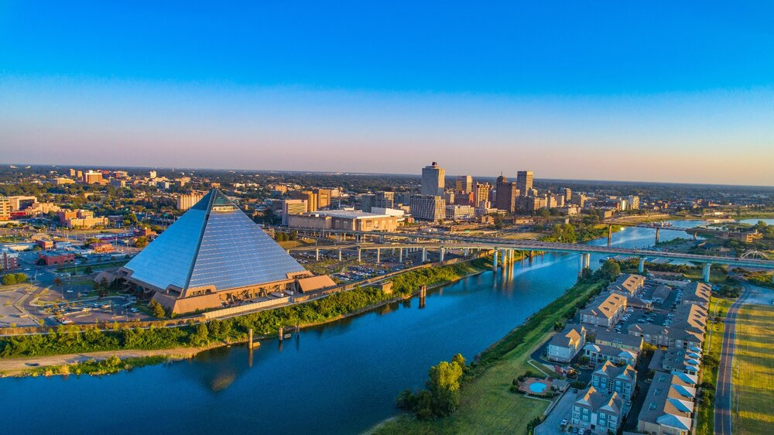

NOMAN010520
STRONG HEALTHY THRIVING NEIGHBORHOODS STRONG HEALTHY THRIVING NEIGHBORHOODS STRONG HEALTHY THRIVING NEIGHBORHOODS STRONG HEALTHY THRIVING NEIGHBORHOODS STRONG HEALTHY THRIVING NEIGHBORHOODS STRONG HEALTHY THRIVING NEIGHBORHOODS STRONG HEALTHY THRIVING NEIGHBORHOODS STRONG HEALTHY THING NEIGHBOR
December 10, 2024
H
OODS STRONG HEALTHY THRIVING NEIGHBORHOODS STRONG HEALTHY THRIVING NEIGHBORHOODS STRONG HEALTHY THRIVING NEIGHBORHOODS STRONG HEALTHY THRIVING NEIGHBORHOODS STRONG HEALTHY THRIVING NEIGHBORHOODS
FUNDING OVERVIEW FOR
REAL ESTATE PROJECTS
AFFORDABLE HOUSING DEPARTMENT
MEMPHIS AFFORDABLE TRUST FUND PROGRAM
HOME-AMERICAN RESCUE PLAN (ARP) PROGRAM

Slide 2

AFFORDABLE HOUSING PROGRAMS
AGENDA
Welcome/Purpose – Ashley Cash, HCD Director
Introductions of the AHD Team – Twarla Guest, Affordable Housing Administrator
Memphis Affordable Housing Trust Overview – Jocelyn Eddins, Sr. Manager Affordable Homeownership & Rental Development
HOME-ARP Overview for Affordable Rental Housing – James Thornton, HOME-ARP Manager
Q & A – HCD/AHD Team
Wrap-Up – Twarla Guest

Slide 3
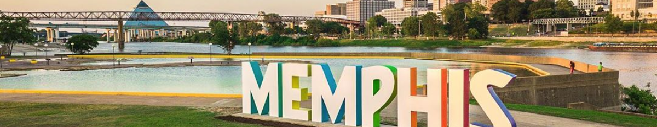

OVERVIEW OF:
MEMPHIS AFFORDABLE HOUSING TRUST (MATHF) PROGRAM

Slide 4
AFFORDABLE HOUSING PROGRAM:
MEMPHIS AFFORDABLE HOUSING TRUST PROGRAM (MATHF)
What is the purpose of the Memphis Affordable Housing Trust Fund ?
The primary objective of the Memphis Affordable Housing Trust Fund is to:
Increase safe, quality, affordable housing
Improve Neighborhoods
Expand the capacity of nonprofit and for-profit housing developers
Provide gap funding for housing projects

Slide 5
AFFORDABLE HOUSING PROGRAM:
MEMPHIS AFFORDABLE HOUSING TRUST PROGRAM (MAHTF)
MAHTF Program Overview:
  Assist nonprofit and for-profit housing developers with costs related to:
  New construction or rehabilitation of single-family housing
  New construction or rehabilitation of multi-family housing

Slide 6
MEMPHIS AFFORDABLE HOUSING TRUST FUND (MAHTF) PROGRAM
Eligible Activities
New construction of multi-family housing for rent
New construction of single-family housing for rent or home ownership
Rehabilitation of vacant multi-family housing for rent
Rehabilitation of vacant single-family housing for rent or home ownership

Slide 7
MEMPHIS AFFORDABLE HOUSING TRUST FUND (MAHTF) PROGRAM
MAHTF Program Benefits
Reduces Development Budget Gaps
Helps finance construction costs
Provides a development subsidy
No federal regulations to adhere too

Slide 8

APPLICATION EMPHASIS

Slide 9
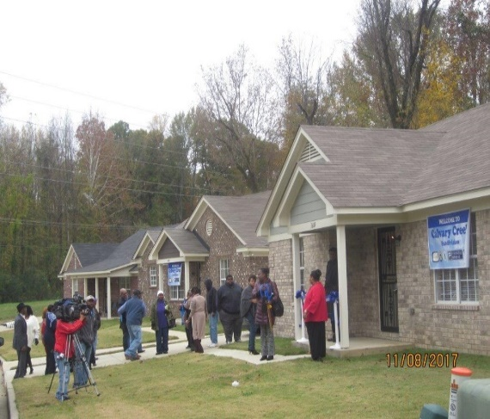
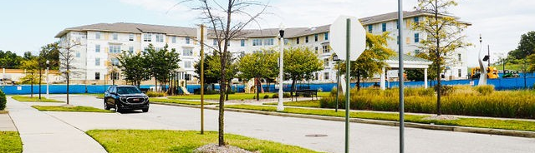
AFFORDABLE HOUSING APPLICATIONS
APPLICATIONS WILL BE EVALUATED ACCORDING TO:
Threshold Assessment
Underwriting Review
NOTE:
Incomplete applications will not be considered
Applications not meeting threshold criteria will not be considered
APPLICATION CHECKLIST
Your guide to a complete application
Read all instructions
DEADLINE DATE for APPLICATION SUBMISSION is
FEBRUARY 13, 2025 by 5:00 pm (CST)

Slide 10
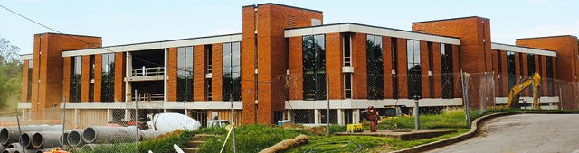
THRESHOLD REQUIREMENTS
SUBMISSIONS/EXHIBITS
Completed AFHMP
Site Plan
Site Control
Appraisal
An Executive Summary including a project timeline with a defined scope of work describing the population to be served
A detailed development budget, proforma, and/or cash flow analysis
ALL APPLICATIONS MUST MEET THE FOLLOWING:
Project serves households at 80% or below the AMI
Project must be located in the City of Memphis & include a site plan
Use for MAHTF funds
Evidence of site control by Applicant
Applicant must provide an appraisal supporting pro forma assumptions

Slide 11

OVERVIEW OF:
HOME-AMERICAN RESCUE PLAN (ARP) PROGRAM

Slide 12
AFFORDABLE HOUSING PROGRAM:
HOME-ARP
AFFORDABLE RENTAL HOUSING PROGRAM
What is the purpose of HOME-AMERICAN RESCUE PLAN (ARP)?
The primary objective of the HOME-ARP program is the development of affordable rental housing by providing funding to:
Provide safe, quality, and affordable housing for individuals and families who meet the definition of Qualifying Populations (QPs).
Promote inclusion of HOME-ARP units in mixed-income housing
  Up to 30% of the units by HOME-ARP funds maybe restricted for occupancy by households that are low-income.
Expand the capacity of nonprofit housing developers.

Slide 13
AFFORDABLE HOUSING PROGRAM:
HOME-ARP
AFFORDABLE RENTAL HOUSING PROGRAM
What are Qualifying Populations (QPs)?
Eligibility for standard HOME assistance is based on household income
  For rental housing most units at or below 60% or 50% AMI (some as high as 80% AMI)
HOME-ARP eligibility does not rely on household income, HOME-ARP is limited to four Qualifying Populations (QPs) – those who are:
  Homeless
  At-risk of Homelessness
  Fleeing, or Attempting to Flee, Domestic Violence, Dating Violence, Sexual Assault, Stalking, or Human Trafficking (VAWA/Trafficking for short)
  Other Populations where HOME-ARP assistance would
    Prevent the household’s homelessness or
    Serve those with the “greatest risk of housing instability”

Slide 14
AFFORDABLE HOUSING PROGRAM:
HOME-ARP
AFFORDABLE RENTAL HOUSING PROGRAM
HOME-ARP AFFORDABLE RENTAL HOUSING Program Overview:
  Acquisition, Construction, Rehabilitation.
  Financial assistance for development subsidies will be in form of a grant.
  Rents cannot exceed limitations established by HUD.
  Tenants must meet the definition of Qualifying Population (QP) as determined by HUD.

Slide 15
AFFORDABLE HOUSING PROGRAM:
HOME-ARP
AFFORDABLE RENTAL HOUSING PROGRAM
CROSS CUTTING REGULATIONS
Environmental Reviews (Historic Reviews, Indian Tribal Reviews)
Fair Housing
Section 3
Davis Bacon (Labor Standards)
Section 504
Violence Against Women Reauthorization Act (VAWA)

Slide 16
HOME-ARP AFFORDABLE RENTAL HOUSING PROGRAM
Eligible Activities
New construction of rental housing
Rehabilitation of rental housing
Site acquisition

Slide 17
APPLICATION EMPHASIS

Slide 18
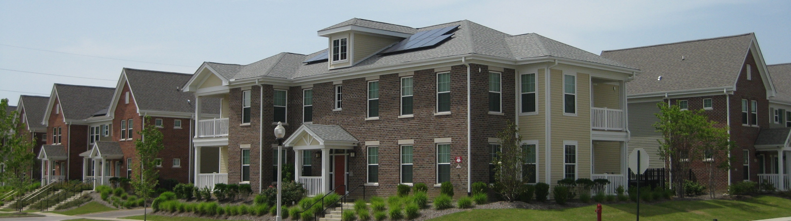
AFFORDABLE HOUSING APPLICATIONS
APPLICATIONS WILL BE EVALUATED ACCORDING TO:
Threshold Assessment
Underwriting Review
NOTE:
Incomplete applications will not be considered.
Applications not meeting threshold criteria will not be considered.
APPLICATION CHECKLIST
Your guide to a complete application
Read all instructions
DEADLINE DATE for APPLICATION SUBMISSION is FEBRUARY 13, 2025 by 5:00 pm (CST)

Slide 19
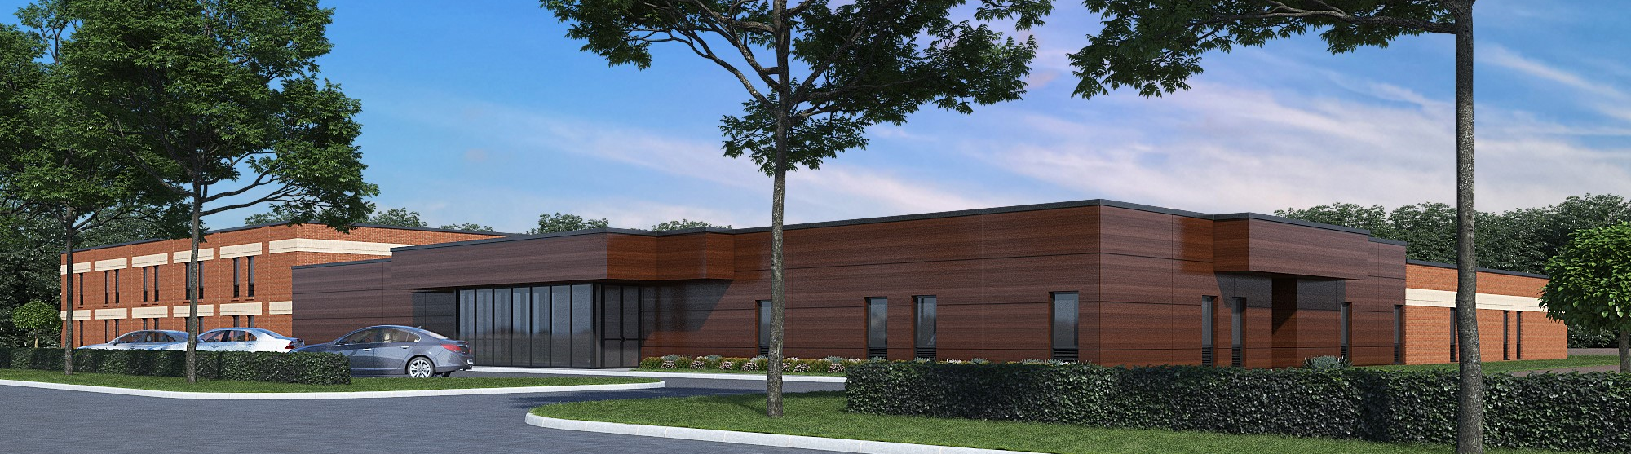
THRESHOLD REQUIREMENTS
SUBMISSIONS/EXHIBITS
Completed AFHMP
Site Plan
Site Control
Appraisal
An Executive Summary including a project timeline with a defined scope of work describing the population to be served
A detailed development budget, proforma, and/or cash flow analysis
ALL APPLICATIONS MUST MEET THE FOLLOWING:
Project serves Qualifying Populations (QPs)
Project must be located in the City of Memphis & include a site plan
Use for HOME-ARP funds
Evidence of site control by Applicant
Applicant must provide an appraisal supporting pro forma assumptions

Slide 20
Questions?
Completed applications can be submitted to
HOUSING AND COMMERCIAL DEVELOPERS - The City of Memphis
DEADLINE DATE for APPLICATION SUBMISSION is
FEBRUARY 13, 2025 by 5:00 pm (CST)
If you have any additional questions after today’s presentation, please contact Kamillah Kelly at 636-7339.
www.memphistn.gov/hcd
(901) 636-7339

