Slide 1


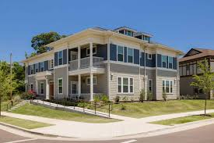


Accessing Grant Funding (FY26) Workshop
Grants Open: December 3, 2024 @ 8 a.m.
Grants Close: January 31, 2024 @ 4 p.m.

Slide 2
TODAY'S AGENDA
FY26 PROGRAMS
SUBMISSION PROCESS
ONLINE PORTAL
BREAKOUT SESSIONS
*A recording of this session and presentation will be available at https://www.memphistn.gov/government/housing-and-community-development/funding-opportunities/

Slide 3
Provide an overview of this year’s funding opportunities.
Review guidelines and requirements.
Discuss the electronic submission.
Engage with program experts during breakout sessions.
Discuss trainings on the electronic portal.
PURPOSE
SCIF WORKSHOP

Slide 4
Strategic Community Investment Funds (SCIF)
FY26 (July 1, 2025 – June 30, 2026)
Competitive Funding Process
Application and selection process consistent and clear.
Available for projects benefiting low/mod persons.
Consolidated Plan Alignment (Priorities/Goals)
Threshold Requirements MUST be met.
Deficient applications will not be considered for review.
Cash Reimbursement. Monthly invoices requested.
City of Memphis Insurance Requirements
Funds Awarded
Eligible Nonprofit Organizations.
For community development and service programs.
Applications must have a minimum score of 75 to be considered.

Slide 5
HCD Programs & SCIF Funding Areas
HOMELESS and SPECIAL NEEDS DEPARTMENT
Emergency Solutions Program Grant (ESG) - $560K
Housing Opportunities for Persons with AIDS (HOPWA) - $3.0M
HOME Funded Tenant-Based Rental Assistance (Home TBRA) - $600K
Community Service Grant (CSG) - $250K
OFFICE OF NEIGHBORHOOD ENGAGEMENT
Neighborhood Partnership Grant (NPG) - $200K
* Estimated Amounts. Pending availability of funds and federal budget allocations.

Slide 6

SCIF FY26 Timeline
SCIF Grant Opens - December 3, 2024 @ 8:00 a.m. (Note: all grants must be submitted via online portal)
SCIF Workshop December 3, 2024 @ 10:00 a.m. (Memphis Public Library)
"How-2" Submit HCD Grants Workshop – January 15, 2025 (6:00 p.m.) Virtual Workshop
Online Portal Training – December 10, 2024, at 10:00 am and January 14, 2025, at 2:00pm (Virtual Training)
Application Period Closes – January 31, 2025 @ 4:00 p.m.

Slide 7
Emergency Solutions Grant (ESG)
Funding Source: ESG Federal Entitlement Funds

Slide 8
Emergency Solutions Grant (Funding Source: ESG)
The Emergency Solutions Grant seek to improve the quality of life for homeless citizens through funding for activities to help homeless families move toward independent living and to prevent homelessness.
Program activities are designed to be the first step in a continuum of services for homeless persons toward independent living.
Match Requirements - dollar for dollar.
Average Award is $50k contingent on the availability of Federal funds.
Eligible Applicants
Nonprofit organizations that serve the homeless population.
Demonstrate at least one year of operating experience and serving the community.

Slide 9


Emergency Solutions Grant
Eligible Activities:
Street Outreach
Emergency Shelter
Homeless Prevention
Rapid Re-housing
Homeless Management Information System (HMIS)

Slide 10
Housing Opportunities for People With AIDS/HIV (HOPWA)
Funding Source: HOPWA Federal Entitlement Funds

Slide 11

HOPWA
The Housing Opportunities for Persons with AIDS program assist low- income individuals diagnosed with HIV/AIDS and their family members who live with them.
Eligible Applicants
Nonprofit Organizations Only
Demonstrate at least one year of experience in serving its community.
Clients must be documented with HIV/AIDS diagnosis and meet HUD income guidelines for the county of their residence within the service area.
Average Award ~$400K annually contingent on the availability of Federal funds
Must increase the availability of decent, safe and affordable housing for low-income persons living with HIV/AIDS.
Must be in Fayette, Shelby, and Tipton Counties in Tennessee, DeSoto, Marshall, Tate, and Tunica Counties in Mississippi, and Crittenden County in Arkansas.

Slide 12

Housing Opportunities for Persons With AIDS (HOPWA)
Eligible Activities:
Acquisition and/or rehabilitation
New Construction of SRO’s or community residences
Operating costs for housing
Short-term supported housing
Rental Assistance
Short-Term Rent Mortgage, and Utility (STRMU)
Permanent Housing Placement
Housing information
Resource Identification
Supportive Services

Slide 13
Home-Funded Tenant Based Rental Assistance (TBRA)
Funding Source: HOME Federal Entitlement Funds

Slide 14
HOME-Funded Tenant Based Rental Assistance
The HOME-TBRA program provides rental assistance to low-income persons who are homeless and have special needs.
Eligibility
Non-profit organizations with 501(c)(3) tax exempt status, current TN charter, financial statements/audit, general liability insurance
Must serve clients whose income is 60% or below the median income and who are at risk of homelessness and have a special need
Clients must have an income and pay 30% of the rent and a portion of utilities
Average Award Amount is $300k contingent on the availability of Federal funds.
Eligible Activities include:
Rental Assistance
Utility Assistance

Slide 15
Community Service Grant (CSG)
Funding Source: City Funds

Slide 16

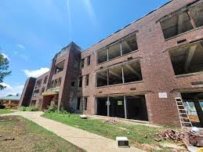
Community Service Grant (CSG)
Eligible Activities
Public Services
Public Facility Improvement
Maximum Award Request - $50k for two years.
Special Populations include the following.
Persons with HIV/AIDS
Persons dealing with mental illness
The elderly
Chronic substance abusers
Persons with developmental and/or physical disabilities
Victims of domestic violence
Youth aging out of foster care
Veterans

Slide 17


Community Service Grant Funding Source: CDBG
CSG is a competitive funding source used to provide supportive services primarily for youth, houseless individuals, and other special needs populations.
Eligibility
Non-profit organizations with 501(c)(3) tax exempt status, current TN charter, financial statements/audit, general liability insurance, etc.
Must document the income of clients and provide documentation of homelessness.
Agency must be in operations at least one year.

Slide 18
Neighborhood Partnership Grant (NPG)
Funding Source: City Funds

Slide 19
Neighborhood Partnership Grant
The Neighborhood Partnership Grant provides funding for neighborhood service-oriented programs that benefit neighborhoods.
Eligibility
Nonprofit Organizations Only
Business/Economic Development
Community Development
Community Initiatives
Demonstrate at least one year of experience in serving its community.
Maximum Request - $15k

Slide 20



Neighborhood Partnership Grant
SBE/MBE/WBE Programs
Job Creation
Neighborhood Clean-Ups
Capacity Building
Eligible Activities include:
Workforce Development
Youth Development
Economic Development
Activities that Support Affordable Housing

Slide 21
Federal Compliance & Monitoring

Slide 22
Program Compliance
The Compliance & Monitoring Department is responsible for ensuring all Federal Programs (CDBG, ESG, HOME & HOPWA) administered by HCD comply with federal guidelines and regulations which are established by the U.S. Department of Housing and Urban Development (HUD). The primary focus of Compliance Monitoring is threefold:
1.Ensuring sub-recipients comply with grant guidelines and federal
requirements, which include:
Program Eligible Activities:
Serving Persons earning 80% or less of AMI Ensuring Project Affordability Periods
Environmental Review
Labor Standards-Davis Bacon
Americans with Disability Act Guidelines (ADA) & Section 504
Section 3
2. Monitoring programs and projects
3. Providing technical assistance to internal program managers and external sub- recipients

Slide 23
Contract Insurance Requirements
All City of Memphis insurance requirements must be met at the time of contract.
Approved Waivers
Automobile
Workmen's Comp
General Liability
Note: Program staff will review specific requirements during breakout sessions.

Slide 24
Application Components

Slide 25
SCIF Application Components
Applicant Profile
Organizational Information
Highlights Capacity
Experience
Financials/Agency Budget
Application Per Program Area
Program Narratives
Program Budget Information

Slide 26

Agency Budget Overview
This is a threshold item. If not attached, your application will not be considered for review.
Add where requested in the "PROFILE section".
This budget provides a view of your overall AGENCY financials (i.e., revenues, expenses, etc.)

Slide 27
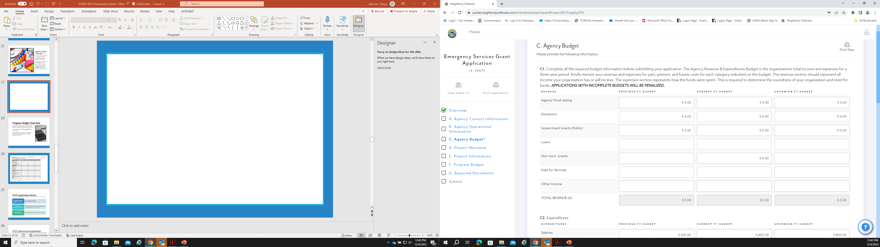

Slide 28
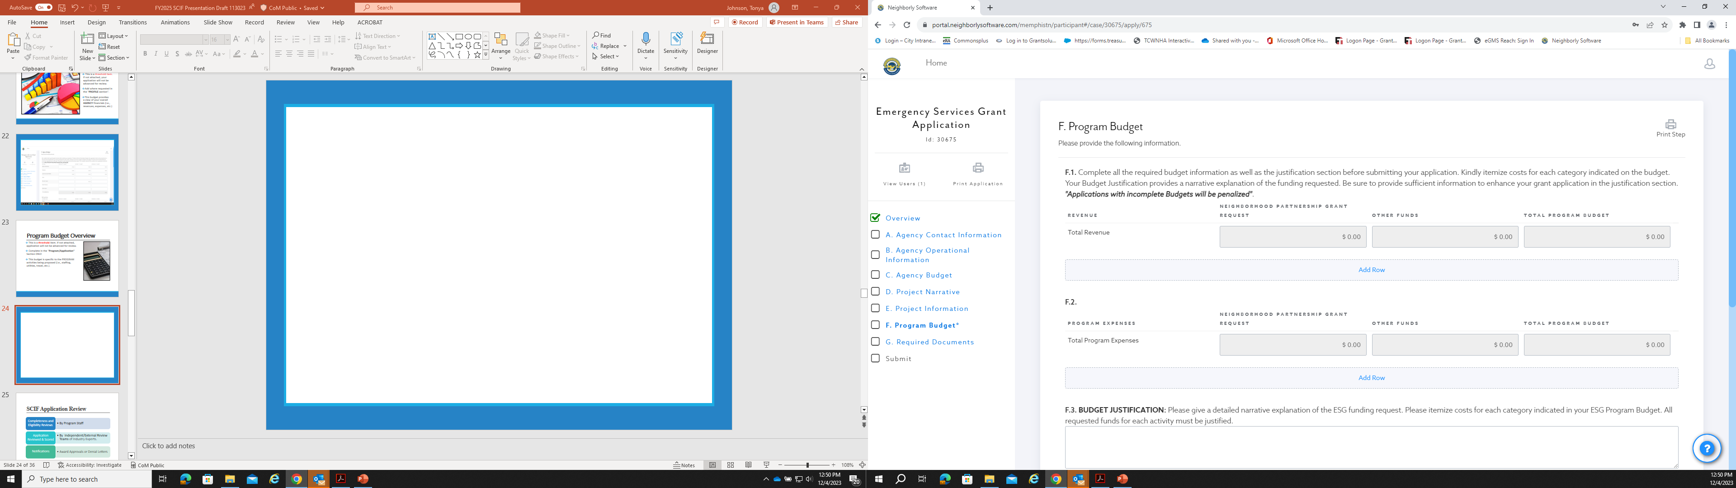

Slide 29
SCIF Application Review
Application Reviewed & Scored
By Independent/External Review Teams of Industry Experts.
Notifications
Award Approvals or Denial Letters
By Program Staff
Completeness and Eligibility Reviews

Slide 30
SCIF Submission Requirements
Electronic Submission
Electronic Applications links found on the HCD page from SCIF funding opportunities.
Applicant Profile
Project Applications
Set Deadline
January 31, 2024, at 4:00 p.m. via electronic submission portal.

Slide 31
Submitting Your Grant
FY26

Slide 32
Electronic Submission Process
Access
Access links to applications from HCD web page. Select "Funding Opportunities".
Create
Create an account with email and password.
Program Overview
Review Program Guidelines
Matrix of Required Documents
Program Application
Complete program application(s)
Move to Application Agency information, upload required documents, agency and program budgets, experience narratives.
Save/Submit
Applications can be saved until ready for submission. Please print application for your files.

Slide 33
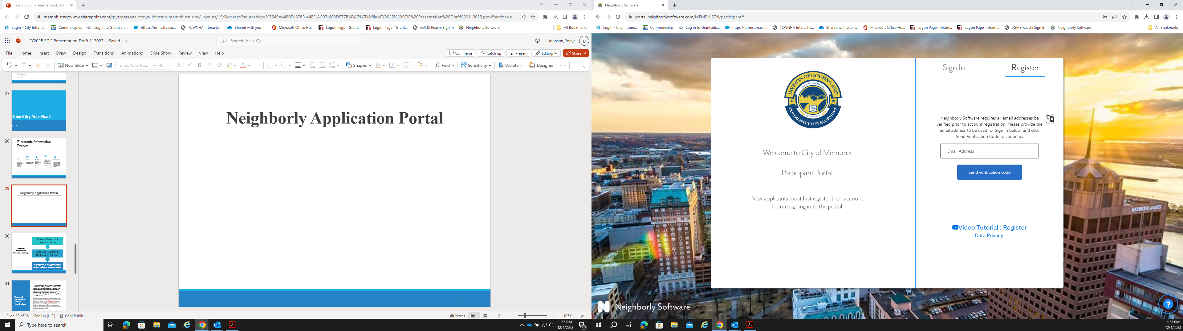
Neighborly Application Portal

Slide 34
Electronic Submission Process Trainings
December 10, 2024, at 10:00 am
January 14, 2025, at 2:00 pm
All trainings will be held virtually (meeting link will be posted on HCD website). All applicants are strongly encouraged to attend.
* Don't forget the "How To" Submit SCIF Grants Workshop – January 16th)

Slide 35
Electronic Submission Process Tips/Updates
Download and review the Program Guide and Matrix of Required Documents located on the City of Memphis-HCD Website. The documents are also located on the funding opportunities section as well as the overview section in the application. Review the documents in to help prepare for completing the application.
Complete each section of the application and upload all required documents. The Agency and Program Budgets are threshold items and must be completed. Documents, narratives, and budgets are intended to provide information about the applicant's agency, not the program. Program information is specific to the program's application section ONLY.
Review the application before submission.
Print a copy of the application for your records.
Notes:
The "Applicant Profile" is intended to provide information/documents about the applicant's agency (i.e., organization information, highlights capacity, experience, financials/agency total operating budget).
NOTE: This section must be completed before continuing to the “Program Application” section because this data integrates into each program application.
· Download and review the list of documents required to be uploaded for each program in advance to help prepare for completing the application.
· The “Program Application” is intended to provide information/documents about the program you are requesting funds (i.e., program narrative, program budget - cost to operate this program ONLY).
Documents, narratives, and budgets in the "Applicant Profile Section" are intended to provide information about the applicant's agency, not the program. Program information is specific to the program's application section ONLY.

Slide 36
Electronic Submission Process Tips
To print and review applications, select the “Printer” icon on the Application Homepage.
Applicants can create a profile using an email and password. The application links is found on the HCD website. BE SURE TO UPDATE DOCUMENTS.
Each Application has a “Save” button. It is best to save as a draft until you are ready to submit as a final. Once submitted the application cannot be changed. Please review draft prior to submitting.

Slide 37

Past SCIF Recipient's

Slide 38

Past SCIF Recipient's

Slide 39
Additional Funding Programs
Memphis Affordable Housing Trust Fund
Neighborhood Economic Development Opportunities
Multi-Family Housing Program/Affordable Rental
Single-Family Housing Program/Affordable Home-Build
HOME-ARP
Community Collation Program (CCP)
Neighborhood Economic Development Opportunity (NEDO)
Middle Income Pilot Program (MIP)
Contract Opportunities
Lead Hazard Reduction Program
Weatherization Program

Slide 40
ASK THE PANEL
General Questions
Remainder of the workshop is an opportunity for attendees to meet with staff from various programs.
Learn more about each program
Discuss program ideas
Ask questions
For more information about submitting your grant application contact Tonya Johnson, Grants Coordinator at (901) 636-7387 or Tonya.Johnson@memphistn.gov.
Program related questions should be directed to the respective program staff.

Slide 41
Next… Breakout Sessions
Neighborhood Partnership Grant (NPG)
Emergency Solutions Grant (ESG)
Community Service Grant CSG)
Housing Opportunities For People With Aids (HOPWA)
HOME Tenant-Based Rental Assistance (HOME-TBRA)

Slide 42
The End – Thank You for Attending!
For More Information Contact
Ebunoluwa Odeyemi, Administrator, Planning and Policy Department
Ebunoluwa.Odeyemi@memphistn.gov
(901) 636-7434
Tonya Johnson, Grants Coordinator
Tonya.Johnson@memphistn.gov
(901) 636-7387
Program Staff (request connection)
HCD – Receptionist (901) 636-7300

Slide 43
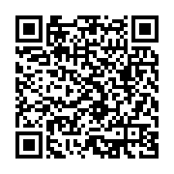
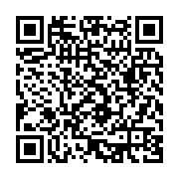
Electronic Submission Process Trainings
December 10, 2024, at 10:00 am
January 14, 2025, at 2:00 pm

